Slide 1
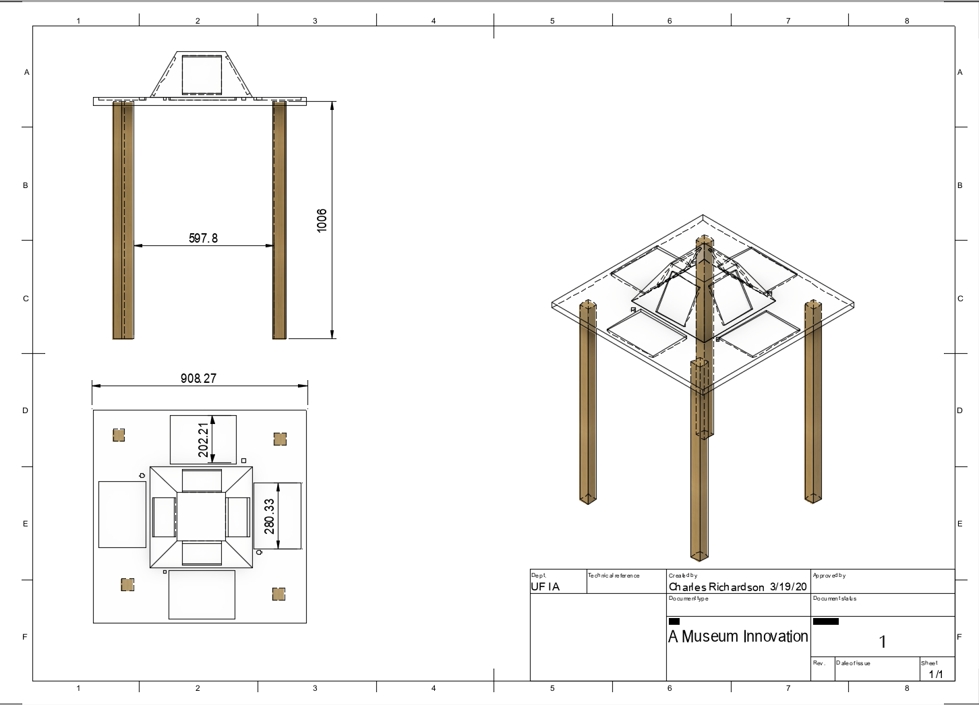
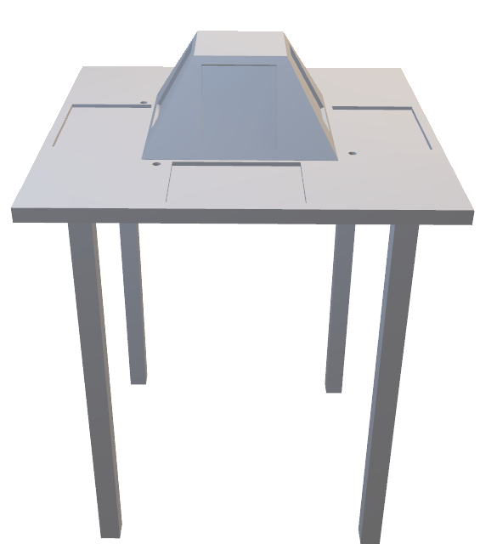
How it works
8 slots for tablet sized technology, 2 per area
Tablet 1: (Centerpiece)
Non-touch tablet for information and inspiration purposes.
Prompts the visitor to attempt to create small works of their own (on tabletop tablet)
Tablet 2: (Tabletop)
Dedicated to inspiring creativity and involvement (from centerpiece tablet)
Allows visitors to create their own works through touchscreen capabilities
Versatile workspace allows room for non-tech activities.

